Slide 1


One hot Encoding

Slide 2
Document #1
Document #2
He is a good boy. She is also good.
Radhika is a good person.
Vocabulary
a, also, boy, good, He, is, person, She, Radhika
 | a | also | boy | good | He | Is | person | She | Radhika
Index | 0 | 1 | 2 | 3 | 4 | 5 | 6 | 7 | 8
Document #1 | 1 | 1 | 1 | 2 | 1 | 2 | 0 | 1 | 0
Document #2 | 1 | 0 | 0 | 1 | 0 | 1 | 1 | 0 | 1
Document as Vector

Slide 3
Document #1
Document #2
He is a good boy. She is also good.
Radhika is a good person.
Vocabulary
a, also, boy, good, He, is, person, She, Radhika
Word | Index
a | 0
also | 1
boy | 2
good | 3
He | 4
is | 5
person | 6
She | 7
Radhika | 8
Assign index for each word in Vocabulary

Slide 4
Word | Index | 0 | 1 | 2 | 3 | 4 | 5 | 6 | 7 | 8
a | 0 | 1 | 0 | 0 | 0 | 0 | 0 | 0 | 0 | 0
also | 1
boy | 2
good | 3
He | 4
is | 5
person | 6
She | 7
Radhika | 8
Words as Vector

Slide 5
Word | Index | 0 | 1 | 2 | 3 | 4 | 5 | 6 | 7 | 8
a | 0 | 1 | 0 | 0 | 0 | 0 | 0 | 0 | 0 | 0
also | 1 | 0 | 1 | 0 | 0 | 0 | 0 | 0 | 0 | 0
boy | 2
good | 3
He | 4
is | 5
person | 6
She | 7
Radhika | 8
Words as Vector

Slide 6
Word | Index | 0 | 1 | 2 | 3 | 4 | 5 | 6 | 7 | 8
a | 0 | 1 | 0 | 0 | 0 | 0 | 0 | 0 | 0 | 0
also | 1 | 0 | 1 | 0 | 0 | 0 | 0 | 0 | 0 | 0
boy | 2 | 0 | 0 | 1 | 0 | 0 | 0 | 0 | 0 | 0
good | 3 | 0 | 0 | 0 | 1 | 0 | 0 | 0 | 0 | 0
He | 4 | 0 | 0 | 0 | 0 | 1 | 0 | 0 | 0 | 0
is | 5 | 0 | 0 | 0 | 0 | 0 | 1 | 0 | 0 | 0
person | 6 | 0 | 0 | 0 | 0 | 0 | 0 | 1 | 0 | 0
She | 7 | 0 | 0 | 0 | 0 | 0 | 0 | 0 | 1 | 0
Radhika | 8 | 0 | 0 | 0 | 0 | 0 | 0 | 0 | 0 | 1
One hot encoding

Slide 7
Document #1
He is a good boy. She is also good.
Document#1 | Word Index | 0 | 1 | 2 | 3 | 4 | 5 | 6 | 7 | 8
He | 4 | 0 | 0 | 0 | 0 | 1 | 0 | 0 | 0 | 0
is | 5 | 0 | 0 | 0 | 0 | 0 | 1 | 0 | 0 | 0
a | 0 | 1 | 0 | 0 | 0 | 0 | 0 | 0 | 0 | 0
good | 3 | 0 | 0 | 0 | 1 | 0 | 0 | 0 | 0 | 0
boy | 2 | 0 | 0 | 1 | 0 | 0 | 0 | 0 | 0 | 0
She | 7 | 0 | 0 | 0 | 0 | 0 | 0 | 0 | 1 | 0
is | 5 | 0 | 0 | 0 | 0 | 0 | 1 | 0 | 0 | 0
also | 1 | 0 | 1 | 0 | 0 | 0 | 0 | 0 | 0 | 0
good | 3 | 0 | 0 | 0 | 1 | 0 | 0 | 0 | 0 | 0
Document as Matrix

Slide 8
Document #2
Radhika is a good person.
Document#1 | Word Index | 0 | 1 | 2 | 3 | 4 | 5 | 6 | 7 | 8
Radhika | 8 | 0 | 0 | 0 | 0 | 0 | 0 | 0 | 0 | 1
is | 5 | 0 | 0 | 0 | 0 | 0 | 1 | 0 | 0 | 0
a | 0 | 1 | 0 | 0 | 0 | 0 | 0 | 0 | 0 | 0
good | 3 | 0 | 0 | 0 | 1 | 0 | 0 | 0 | 0 | 0
person | 6 | 0 | 0 | 0 | 0 | 0 | 0 | 1 | 0 | 0
Document -> 5 x 9 matrix

Slide 9
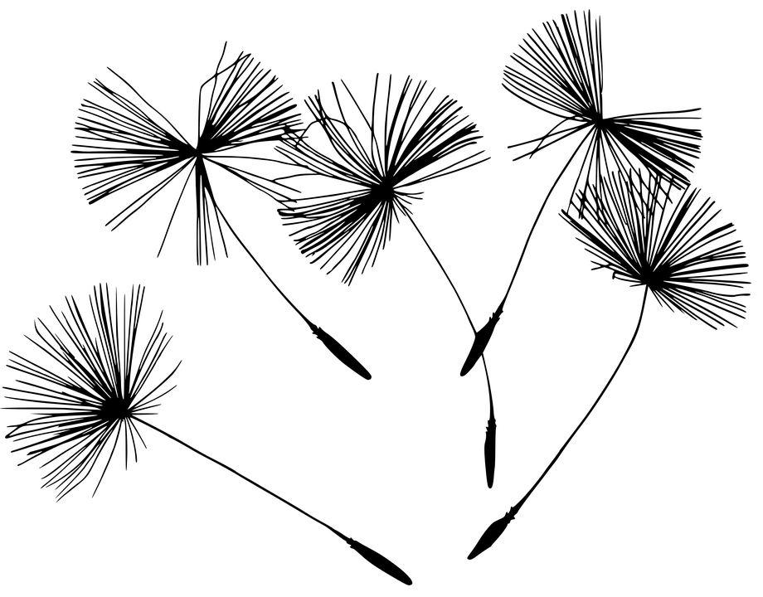
Discovering relationships between Words

Slide 10
King, Queen, Man, Woman, Child
Vocabulary

Slide 11
King, Queen, Man, Woman, Child
Vocabulary
King
1 | 0 | 0 | 0 | 0
Queen
One hot vector
0 | 1 | 0 | 0 | 0
Child
0 | 0 | 0 | 0 | 1

Slide 12
King + Man = Queen + ?
Can we use TF-IDF or one hot vector to solve this equation?

Slide 13
King + Man = Queen + Woman
440
480
410
510
920 = 920

Slide 14
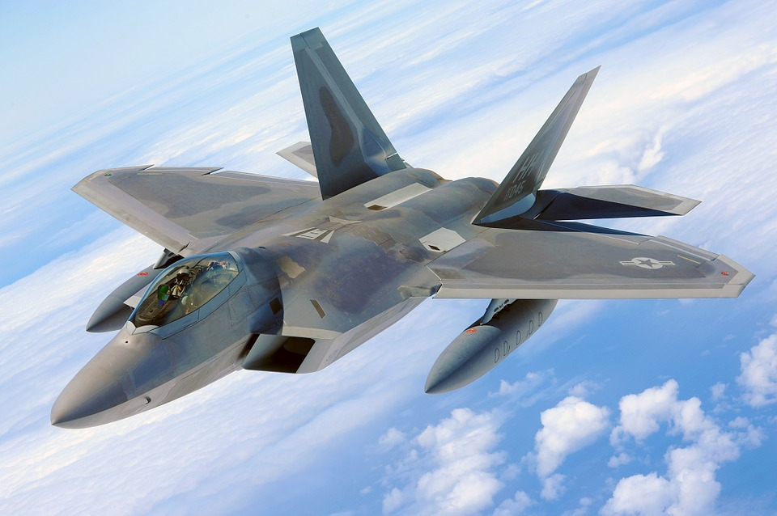

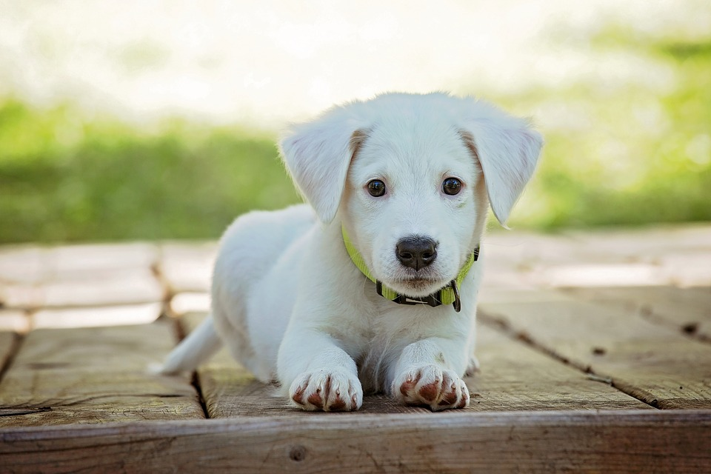
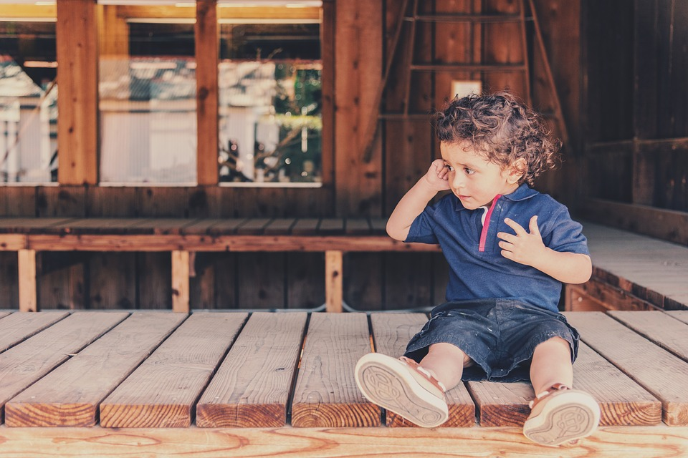
Which is similar to ‘cat’
Plane
Bed
Dog
Boy

Slide 15
Discovering Semantic relationship using
Word2Vec

Slide 16

What does Word2Vec do?

Slide 17
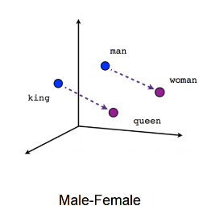

Slide 18
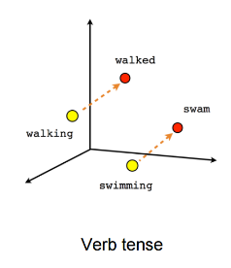

Slide 19
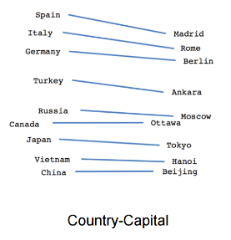

Slide 20
How does Word2Vec works?

Slide 21
The | Sun | rises | in | the | east
Given a word, what are the nearby word(s)

Slide 22
Context, Target pair
The | Sun | rises | in | the | east
(Sun, The)

Slide 23
Context, Target pair
The | Sun | rises | in | the | east
(Sun, The)
The | Sun | rises | in | the | east
(The, Sun) (rises, Sun)

Slide 24
Context, Target pair
The | Sun | rises | in | the | east
(The, sun)
The | Sun | rises | in | the | east
(Sun, The) (Sun, rises)
The | Sun | rises | in | the | east
(Sun, rises) (in, rises)

Slide 25
Find probability of a word being ‘nearby word’
Context, Target pair
The | Sun | rises | in | the | east
(Sun, The)
The | Sun | rises | in | the | east
(The, Sun) (rises, Sun)
The | Sun | rises | in | the | east
(Sun, rises) (in, rises)

Slide 26
What is considered near?

Slide 27
Window Size
The | Sun | rises | in | the | east
Window size = 1
(rise, in) (the, in)

Slide 28
Window Size
The | Sun | rises | in | the | east
Window size = 1
(in, rises) (in, the)
Window size = 2
(rises, in) (Sun, in) (the, in) (east, in)

Slide 29
Word2Vec Embeddings
2 ways to get it

Slide 30
CBOW model
W_{t-2}
Neural Network
W_{t-1}
Context words
Predict the ‘target’ word
W_{t+1}
W_{t+2}

Slide 31
CBOW model
The
Neural Network
Sun
Context words
rises (‘target’ word)
in
the

Slide 32
Skip-Gram model
W_{t-2}
Neural Network
W_{t-1}
Predict the ‘Context’ words
W_{t}
W_{t+1}
Target word
W_{t+2}

Slide 33
Skip-Gram model
The
Neural Network
sun
Predict the ‘Context’ words
W_{t}
in
rises
the

Slide 34
Which approach will work better?

Slide 35
Skip-Gram

Slide 36

Building
Skip-Gram model

Slide 37
Let’s build a very simple Neural network
1 Input Layer, 1 Hidden Layer, 1 Output Layer

Slide 38
The Input Layer

Slide 39
Input word as One hot
0
1
0
0
0
...
...
0
0
W_{t}

Slide 40
Input word as One hot
0
1
0
0
0
...
...
0
0
Size of the input vector?
W_{t}

Slide 41
Input word as One hot
0
1
0
0
0
...
...
0
0
Same as vocabulary size
W_{t}

Slide 42
Input word as One hot
0
1
0
0
0
...
...
0
0
[1,10000]
Assume we have 10000 words vocabulary
W_{t}

Slide 43
The Hidden Layer

Slide 44
Input word as One hot
0
1
0
0
0
...
...
0
0
[1,10000]
How many neurons in hidden layer?
W_{t}

Slide 45
Input word as One hot
[50]
0
1
0
0
0
...
...
0
0
[1,10000]
Let’s have 50
(or whatever you like)
W_{t}

Slide 46
Input word as One hot
[50]
0
1
0
0
0
...
...
0
0
[1,10000]
How many hidden layer outputs for each Word?
W_{t}

Slide 47
Input word as One hot
[50]
0
1
0
0
0
...
...
0
0
[1,10000]
50
Same as number of neurons in hidden layer
W_{t}

Slide 48
The Output Layer

Slide 49
Input word as One hot
[50]
0
1
0
0
0
...
...
0
0
...
[1,10000]
...
How many Outputs?
...
W_{t}

Slide 50
Input word as One hot
[50]
0
1
0
0
0
...
...
0
0
...
[1,10000]
...
10,000
Same as Vocabulary size
...
W_{t}

Slide 51
Input word as One hot
[50]
0
1
0
0
0
...
...
0
0
...
[1,10000]
...
10,000
Predictions are a lot...how do we handle it better?
...
W_{t}

Slide 52
Input word as One hot
[50]
0
1
0
0
0
...
...
0
0
...
[1,10000]
...
10,000
Predictions are a lot...how do we handle it better?
...
NEGATIVE SAMPLING
W_{t}

Slide 53
Negative Sampling
Only a few weights are updated
Weights corresponding to Positive outputs (Window Size)
Very small number of weights for Negative output
5-20 for small datasets
2-5 for Large dataset

Slide 54
What happens after training?

Slide 55
Input word as One hot
[50]
0
1
0
0
0
...
...
0
0
...
[1,10000]
...
Output Layer is discarded
...
W_{t}

Slide 56
Input word as One hot
[50]
0
1
0
0
0
...
...
0
0
[1,10000]
For each Word in vocabulary, we get...
50 numbers
W_{t}

Slide 57
Input word as One hot
[50]
0
1
0
0
0
...
...
0
0
[1,10000]
For each Word in vocabulary, we get...
50 numbers
Embedding Size
W_{t}

Slide 58
This is how we convert words into numbers…
and discover semantic relationships between words

Slide 59
Building Word2Vec Model
Using gensim

Slide 60
Installing gensim
pip install gensim
For Windows, you may need to install numpy package with MKL which can be downloaded from the following URL:
http://www.lfd.uci.edu/~gohlke/pythonlibs/#numpy

